Slide 1
Review of Network Basics & Common Protocols
INFSCI 1075: Network Security
Amir Masoumzadeh

Slide 2
Outline
What is a computer network?
OSI reference model
TCP/IP
Network Protocols

Slide 3
What is a Computer Network?
A network is a collection of end systems, interconnected by intermediate systems

Slide 4
What is a Computer Network?
Software and hardware infrastructure
  Allow access to different types of resources (original purpose)
    Computing resources, input/output devices, files, databases, etc.
  It provides a medium through which geographically dispersed users may communicate (e.g., email, chatting, teleconferencing)
  An information highway, national information infrastructure

Slide 5
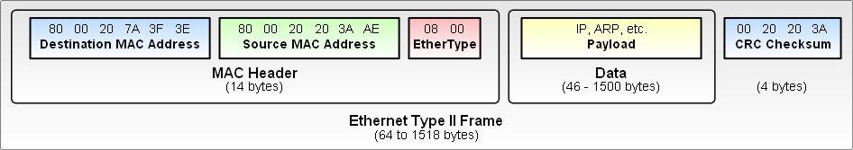
Ethernet frame
Preamble
  Communication pulses to initiate the send
Header
  Source, destination, length/type
Data
  Data + protocol info, 46-1500 bytes, sequencing, padding
Frame-Check Sequence

Slide 6
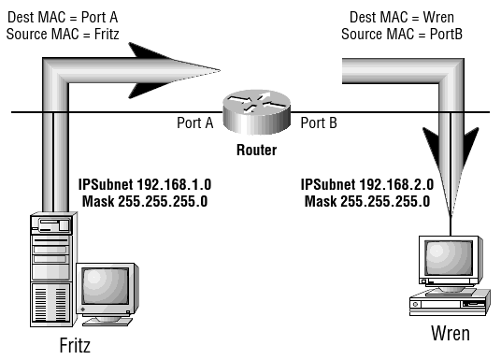
A Transmission Scenario
MAC (Media Access Control) address
  Unique number
  6 bytes (12-digit hex), first 3 bytes identifies manufacturer
ARP (Address Resolution Protocol)
  Finds a node address

Slide 7
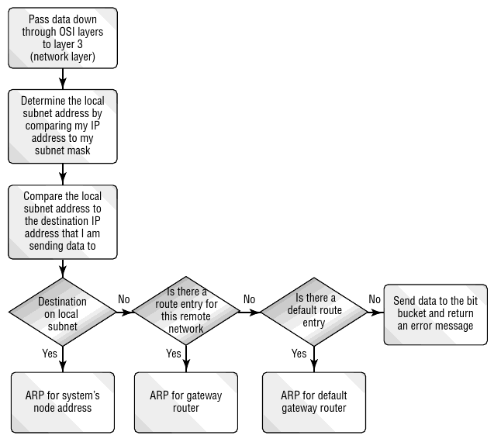
A Transmission Scenario (ARP Decision Process)

Slide 8
A Transmission Scenario (rules?)
Data is received in one piece?
Acknowledgement of receipt?
Acknowledgement per frame/group of frames
Where to send if destination is not in the same local network
If the target is a specific application (e-mail, transfering a file, etc.), how to transfer data to the right application?
Need a protocol!
Why not specified by topology?
  Diversity of topologies

Slide 9
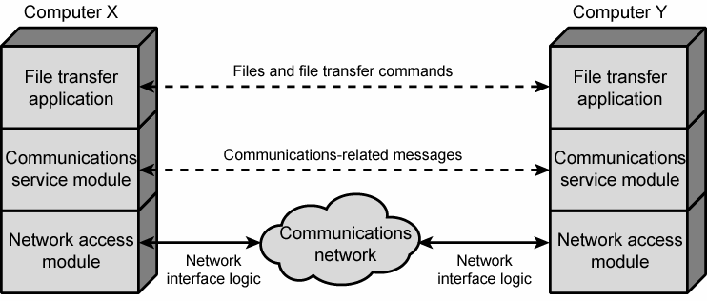
OSI Model
Open System Interconnect Reference Model
  By International Organization for Standardization (ISO) in 1977
7 layers, each layer describes
  How its communication process should function
  How it interfaces with layers directly below and above it, or adjacent to it on other systems
A Protocol Stack

Slide 10
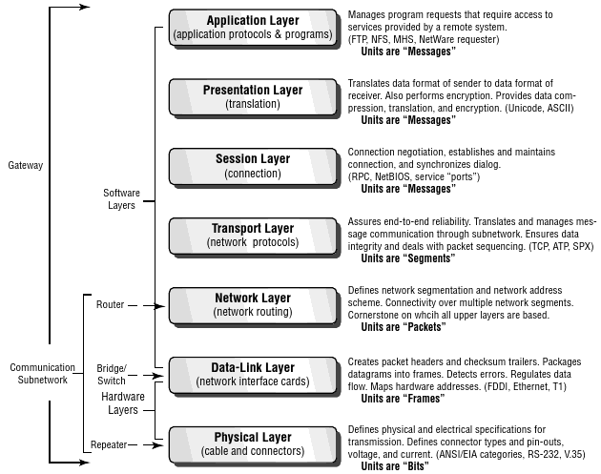
OSI Layers

Slide 11
OSI Layers
Physical Layer
  Provides only the means of transmitting raw data over a physical medium
    Specifications of transmission media, connectors, and signal pulses
  Defines a standard for electronic communication, nothing else (no packets, headers, etc.)
  Examples
    Repeater and hub
    V.92 (modems), RS-232, USB, IEEE1394, ISDN

Slide 12
OSI Layers
Data-Link Layer
  Specifications of topology and communication between local systems
    Packet headers and checksum trailers
    Packages datagram into frames
    Detect errors
    Regulate data flow
    Maps hardware addresses
  Examples
    Ethernet: works with multiple physical layer specs (twisted pair cable, fiber) and multiple network layer specs (IPX, IP)
    FDDI, T1
    Bridges and switches

Slide 13
OSI Layers
Network Layer
  Defines network addresses and how systems on different network find one another
    Network segmentation and network address scheme
    Connectivity over multiple network segments
  Examples
    IP (IPV4/IPV6), IPX, DDP

Slide 14
OSI Layers
Transport Layer
  Responsible for end-to-end message transfer between processes / applications
    Assures end-to-end reliability
    Translates and manages message communication through subnetworks
    Ensures data integrity
    Packet sequencing
  Examples
    IP’s Transmission Control Protocol (TCP), User Datagram Protocol (UDP), IPX’s Sequence Packet Exchange (SPX), and AppleTalk’s AppleTalk Transaction Protocol (ATP).

Slide 15
OSI Layers
Session Layer
  Establishing and maintaining a connection between two or more systems
    Connection negotiation
    Establishing and maintaining connection
    Synchronizing dialog

Slide 16
OSI Layers
Presentation Layer
  Ensures the suitable format of the data for an application
    Translate data format of sender to data format of receiver
    Encryption
    Data compression
    Data and language translation

Slide 17
OSI Layers
Application Layer
  Determines when access to network is required
    Manages program requests that require access to services provided bya remote system
  Not to be confused with an actual program running on a system
    Used by programs for network communication.
    Data is passed from the program to this layer to be encoded in application-specific communication protocol
    Usually each program or application class has its own protocol (although there are standards)
    In some cases, more than one protocol may be used at the application layer for different purposes
    In the TCP/IP model, the application layer includes any functional / protocols present at the presentation and session layers of the OSI models
  Examples: Bittorrent, DHCP, DNS, FTP, HTTP, H.323, IMAP, MIME, POP, RDP, SIP, SMTP, Telnet, etc.

Slide 18
How OSI works: sending a remote file request by word processing application
Application layer
  creates the request to access the file
Presentation layer
  encrypts if needed
Session layer
  checks the application that is requesting and the service that is been requested
  adds information for remote system to correctly handle this request
Transport layer
  ensures it has a reliable connection
  starts splitting and sequencing the information if it would not fit in one frame
Network layer
  adds the source and dest. network addresses
Data-link layer
  ensures data fit in the limited size
  adds frame header including MAC addresses and CRC trailer
  transmits the frame
Physical layer
  simply passing signal pulses

Slide 19
How OSI works: receiving data on remote system
  Physical layer
  Data-link layer
    Notices its own MAC address and so should process this request
    CRC check and if match strips off the header
    What if CRC check fails?
  Network layer
    Notices its own destination software address
  Transport layer
    Ensures it has all packets in a sequence,
    What if some packets are missing?
  Session layer
    Verifies if it is from a valid connection
  Presentation layer
    Analyze the frame
    Perform any translation/decryption needed
  Application layer
    Ensures the correct process receives the request

Slide 20
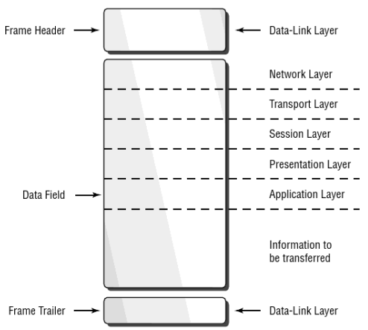
How OSI works: frame structure

Slide 21
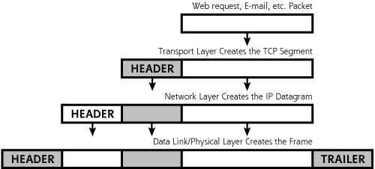
Encapsulation
As a message is passed down through the stack, each layer adds its own control information in the form of a header
  The original message (previous headers and data) gets encapsulated inside the new message

Slide 22
Networking Protocols
For each layer of the stack there are numerous protocols
  For each protocol there are security issues related to these protocols
  For each security issue there are solutions and security mechanisms
We will focus on a handful of protocols and study specific problems and solutions

Slide 23
Protocols - Ethernet
Considered a link-layer protocol by most
Ethernet is the most widely used LAN protocol
  Competitors –Token ring, FDDI, Frame Relay, PPP, etc.
Developed in 1973 at Xerox and is still going strong
Ethernet is designed to operate on small, Local Area Networks
  Due to its design characteristics, Ethernet does not scale well
  If there are too many hosts (or too much traffic) on an Ethernet network, the efficiency of that network rapidly declines. (less applicable with switched Ethernet)

Slide 24
Protocols - Ethernet
Ethernet uses 48 bit hardware (physical) addresses to deliver packets.
  Traditional “bus” Ethernet does not direct packets at all
  Packets are sent out on the shared medium and the appropriate destination grabs them. (similar to 802.11 today)
  With switched Ethernet, packets are sent directly to the destination, and only the destination
In order to time the transmissions, Ethernet uses CSMA/CD
  Is channel busy?
    If not, transmit
    If yes, wait (for random amount of time) and sense again
  Did collision occur?
    If so, wait (for random amount of time) and then retransmit

Slide 25
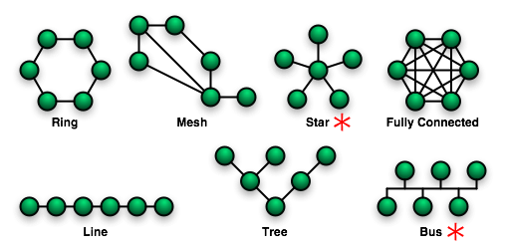
Network Topologies

Slide 26
Network Topologies
Ethernet is commonly seen over two different topologies
  Switched (Star)
    Network is laid out in a star pattern
    Each computer is connected to the switch
    Traffic to a node is delivered to that node alone
    Traffic from that node is delivered only to the switch
  Shared (Bus)
    Network is laid out in a line (or some other shared medium)
    Each computer “taps into” the line
    Traffic to and from a node is sent to all nodes
      Only the target node is supposed to ”pick up” the packet
Token ring is a shared medium similar to bus Ethernet
  Shares some of the same security issues

Slide 27
Protocols - ARP
Address Resolution Protocol
Each node maintains an ARP cache – mapping of MAC/IP addresses (may be dynamic or static)
When an IP packet is received / sent
  Check ARP cache
    If MAC/IP pair is present, forward / send packet
    If not, issue Broadcast asking for MAC/IP pair
    Target node (and only target node) should respond with an ARP reply, which designates a MAC address for the IP address

Slide 28
Protocols - IP
IP is a network layer protocol used for delivering data over a packet switched network
  IP Provides for
    Addressing
    Fragmentation
    Quality of Service
  IP is designed for packet switched networks
  IP is a stateless protocol
  IP provides best effort service
    Data corruption (except header), out-of-order packet delivery, duplication arrival, dropped/discarded packets

Slide 29
Protocols - IP
IP comes in two “flavors”
IPv4
  32 bit addressing
  Variable length header
  Header error checking
  Size limit 65536B
IPv6
  128 bit addressing
  Fixed length header
  No header error checking
  Jumbograms
  Integrated IPSec
  No Fragmentation

Slide 30
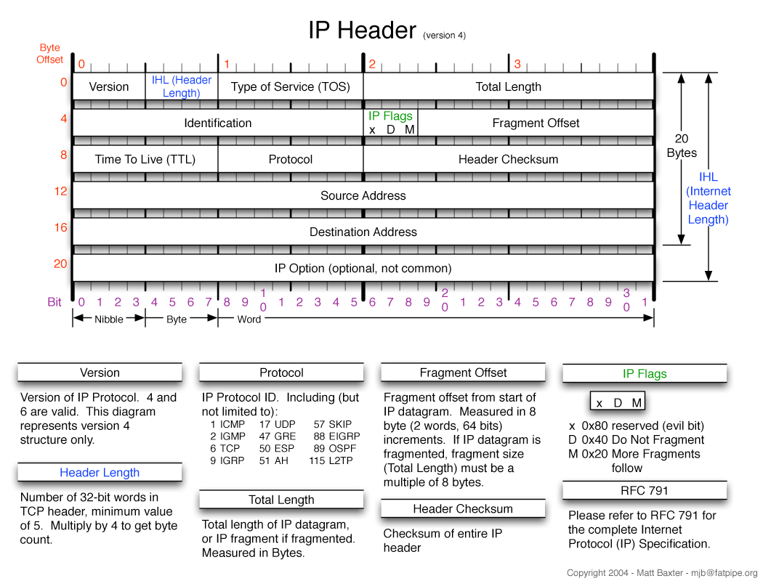
IP Structure (IPv4)

Slide 31
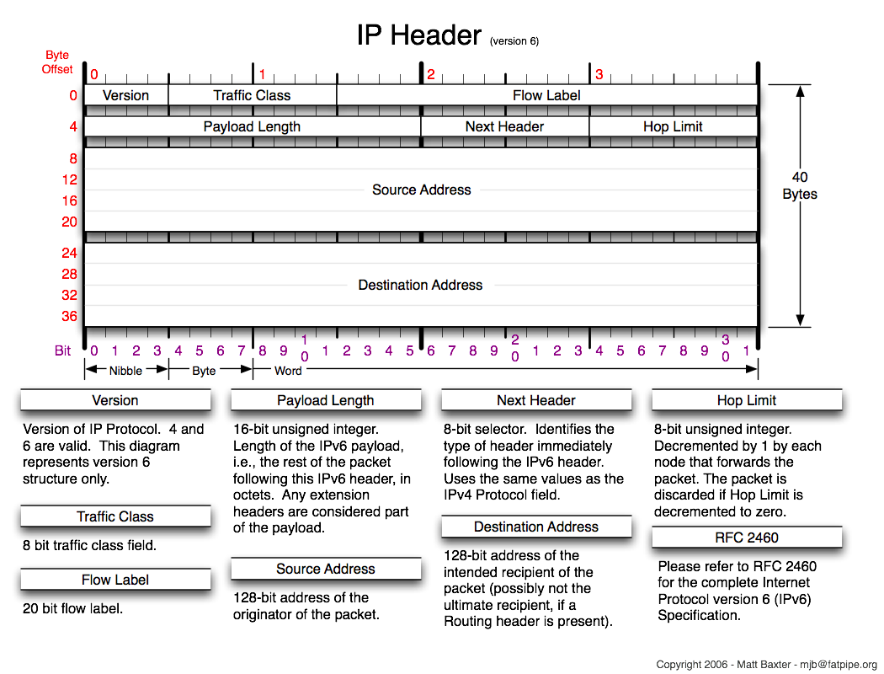
IP Structure (IPv6)

Slide 32
IP Addressing
An IP address is made up of 32 bits
These bits are most commonly seen in “dotted decimal notation”
  4 groups of 8 bits, represented as an integer 0 – 255
Each IP address has a “network” portion and a “host” portion (Subnet)
  May be designated by “/” notation (CIDR)
    136.142.118.4 / 16
  Subnet mask is also a common notation (Classful)
    136.142.118.4 / 255.255.0.0

Slide 33
IP Addressing - Classful
The original structure of IP addresses
Addresses divided in blocks based on octets
Very wasteful of IP Address space
  Smallest network accommodated 256 hosts, next largest 65536
Classful addressing has been superseded by CIDR

Slide 34
IP Addressing - CIDR
Classless Inter-domain Routing
Uses a technique called Variable Length Subnet Masking
  Allows for the division of IP address space into appropriately sized blocks
  Allows for the aggregation of smaller, separated subnets into “supernets”
CIDR supersedes the classful scheme

Slide 35
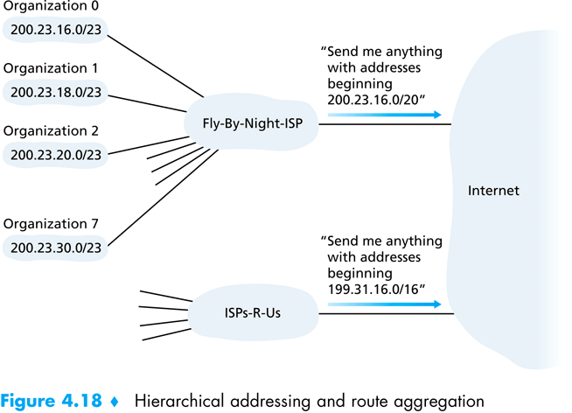
CIDR Example

Slide 36
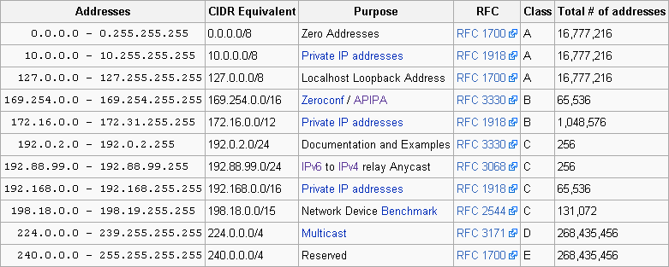
Special IP Ranges
The IP address specification contains several ranges reserved for special purposes

Slide 37
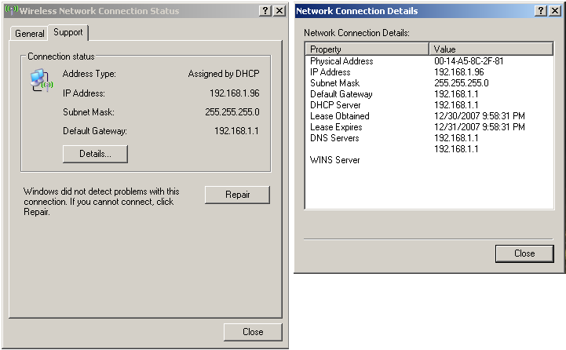
IP Parameters - Example

Slide 38
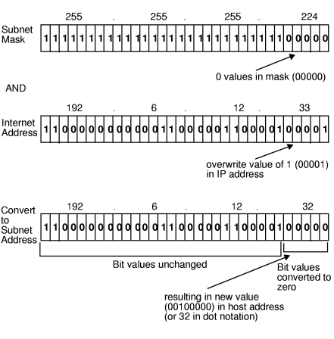
IP Routing
Each node on a network has a locally (globally) unique IP address
  This IP address uniquely identifies the particular node
  Combined with the netmask, it allows a machine to determine its subnet
    i.e., which machines are logically attached directly to its LAN

Slide 39
IP Routing
When a node must send an IP packet
  First it checks its routing table – Does an explicit route exist?
  If no explicit route exists, the machine must determine if the node is on the local subnet
    If so, ARP is used to determine the MAC address of the target
  If the node is not on the local subnet, it is sent to the local gateway (if applicable)
  If there is no local gateway, the destination is deemed “unreachable”

Slide 40
OSPF, RIP, ISIS and BGP
In order to properly route packets, routers and nodes must maintain a routing table of some sort
The type of routing table and protocol used depends on several factors
  “Internal” vs. “External” gateway protocol, size and complexity of network, type of equipment, etc.
RIP is a commonly used “distance vector” algorithm
  RIP routers maintain network reachability information in the form of destination / distance metric pairs
OSPF and ISIS are link state protocols
  Each router computes the shortest path network typology based on broadcasted routing information
BGP is a manually configured routing protocol used at the “core backbone” of the internet
  BGP considers other factors like cost and ownership

Slide 41
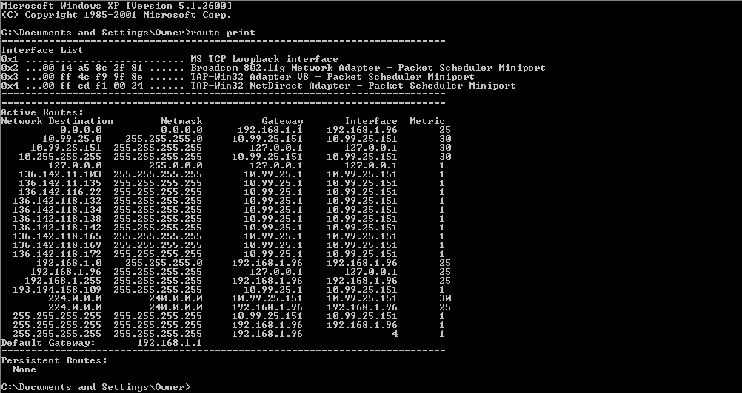
Routing Table

Slide 42
Protocols - ICMP
Internet Control Message Protocol (ICMP) is supposedly a very low-key protocol to answer simple requests
  It sits below the transport layer and above the IP layer of the protocol stack
  No port numbers of any kind - but it has types and codes in the first two bytes of the header
  No concept of client or server - effects are mostly internal to the recipient host
  No guarantees of delivery
Hosts need not be listening to ICMP messages
ICMP messages can be broadcast to hosts
Can be a source of information leaks - e.g. host is unreachable

Slide 43
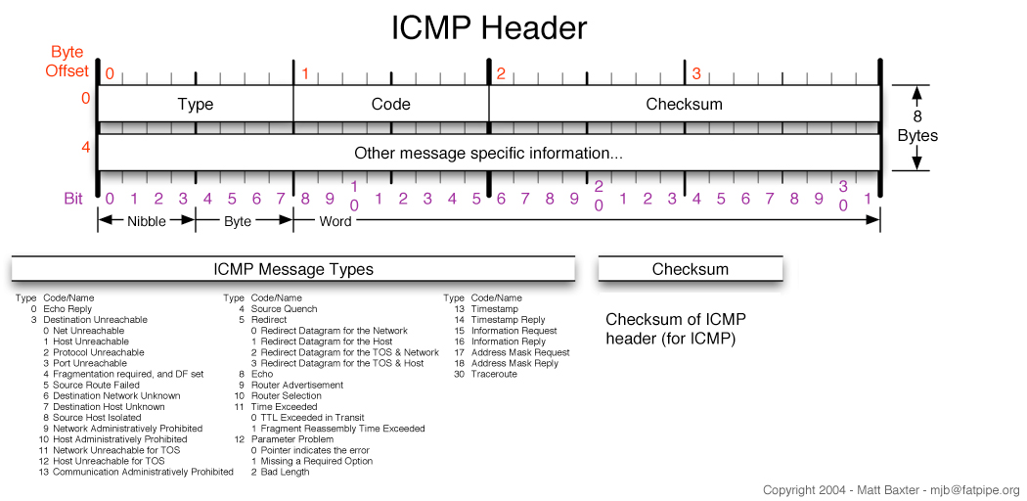
ICMP Structure

Slide 44
ICMP Types & Codes

Slide 45
ICMP Types & Codes
“ping” transmits ICMP (8,0) and receives ICMP (0,0)
“traceroute” uses ICMP
  Sends an ICMP with TTL = 1,2,3,4,... to destination
  Each router along the path detects the TTL has expired and responds with an ICMP (11,0) allowing traceroute to determine the route

Slide 46
Legitimate ICMP Activity
Routers deliver “host unreachable” message
  Common when hosts are shut down for maintenance or otherwise
  Can be used in reconnaissance information
Port unreachable
  ICMP can be used to check if a UDP port is open
  TCP ports reply with a RST/ACK flags
Routers sometime inform you that ICMP traffic is blocked!
Router redirect messages
  Informs host of a more optimum router
Need to fragment packets because MTU is exceeded
TTL expired (time exceeded in transit, e.g. traceroute)

Slide 47
Protocols - TCP
A transport layer protocol that is carried by IP
TCP provides
  Reliability
    TCP ensures that segments make it across the network
    Segments are checked to make sure they were not corrupted
    TCP uses ACKs and retransmissions to achieve this
  Guaranteed order
    TCP delivers the packets in the order in which the were sent
  Flow control
    It throttles the rate at which packets are sent if the receiver or network cannot handle the load
  Multiplexing
    TCP allows many concurrent connections to take place between two end points
    This is achieved using ports

Slide 48
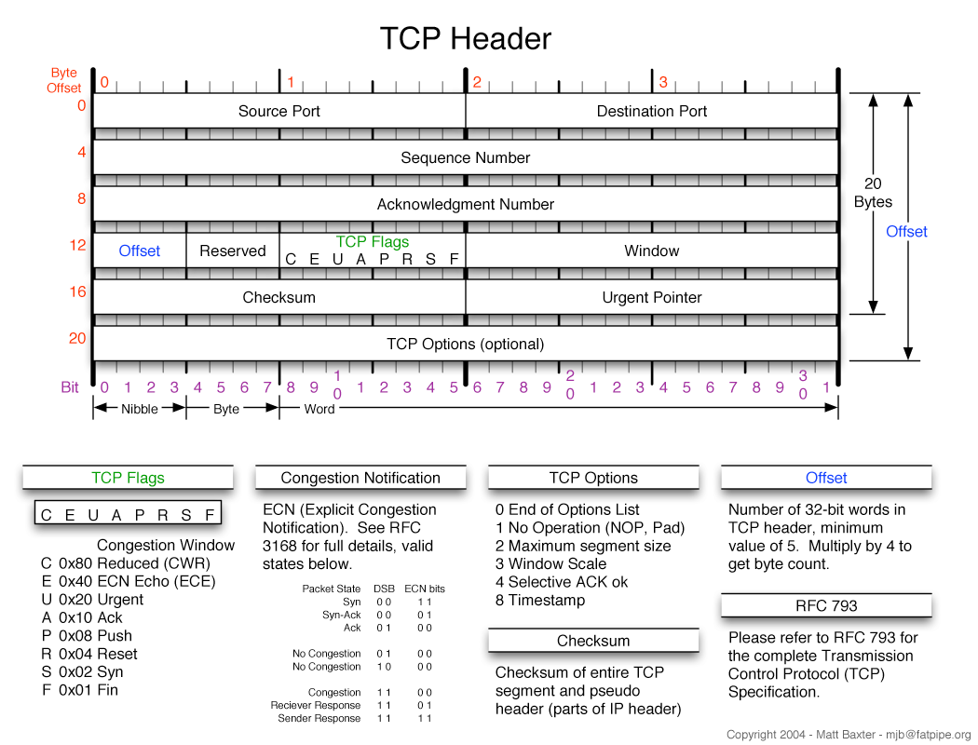
TCP Segment Structure

Slide 49
TCP Segment Structure
Source & Destination Ports
  Designates the originating machine and process as well as the target machine and process
Sequence Number
  Track the number of bytes sent / received
Acknowledgement number
  Designates the next expected sequence number
Flags
  ACK - indicates its ACK field is valid
  RST, SYN and FIN are used for connection set up and tear down
  PSH - send data to higher layers right away
  URG - there is some urgent data

Slide 50
TCP Flags
TCP flags are 6 bits that manage the state of a TCP connection
  ACK – indicate that the packet is acknowledging the receipt of some previous message
  RST – a reset flag indicates that a connection should immediately be aborted
  SYN – Indicates the first packet in a transaction
    Essentially requests a connection
  FIN – Requests a disconnection
  PSH – push indicates that there is no more data, and the data in the buffer now should be sent to the application
  URG – there is some urgent data in the packet (e.g., ctrl-c)

Slide 51
TCP Ports and Processes
When two “machines” communicate across a network, it is actually two processes running on those machines that are communicating
Communicating processes typically have a client side and a server side
  Two processes on two different hosts that communicate using sockets
  A socket is like a door through which messages are sent and received
    Interface between the application process and the transport layer

Slide 52
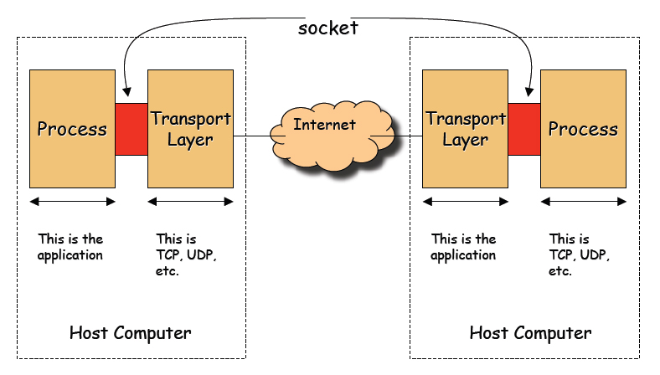
TCP Ports and Processes

Slide 53
TCP Ports and Processes
TCP identifies a connection based on four pieces of information
  Source IP address
  Source Port number
  Destination IP address
  Destination Port number
TCP uses these pieces of information to sort segments and deliver them to the proper process
Port numbers allow TCP to multiplex a single network card / address into a larger number of potential connections

Slide 54
Ports and Servers
Some machines contain processes which constantly “listen” on a particular port for incoming connections
A Client contacts the server initially for all communications
  Server should react to the initial contact – it keeps listening to the port
    It has an initial “socket object” to accept connections
    It creates a new socket dedicated to a particular client after connection
  The initial socket object is what we loosely call as an “open” port
    It is really a half-open object
Popular standard protocols have assigned (fixed) port numbers
  Clients are aware of these numbers before they place a call

Slide 55
Common Port Numbers

Slide 56
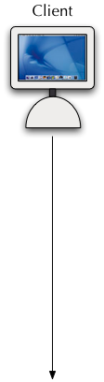




TCP Connection Management
TCP is a stateful protocol
Client wants to initiate connection to server
  It sends a special TCP segment to the server with the SYN bit set to 1
  Let the initial sequence number be client_isn
  This is called a SYN segment
Server receives the SYN segment
  It allocates buffers and variables to the connection and replies
  Reply has SYN = 1, acknowledgment number = client_isn +1
  Sequence number is server_isn
  This is called a SYNACK segment
Connection is completed
This is called the “three way handshake”

Slide 57
TCP Connection Termination
Remember, TCP is stateful!!!
The graceful method to terminate the connection is to use the FIN field followed by ACK
  In this case, either the client or the server will first send a TCP segment with the FIN bit set
  The receiving host will ACK the FIN
  This process closes half the connection - it has to be repeated by the receiving host
The abrupt method of closing the TCP connection is for either the client or the server to send an RST (reset) segment
  This aborts the TCP connection and no further communications take place between the hosts

Slide 58
Sequence Numbers in TCP
Sequence and acknowledgment numbers are very important in TCP for reliable data transfer
  The sequence number of a TCP segment tells the receiver how many bytes of data has been sent
    Example: the first TCP segment carries 1000 bytes of data and the sequence number is 235, the next TCP segment will have a sequence number 1235
  The acknowledgment number tells the recipient what is the next expected byte number
    Example: the server receives 1000 bytes from the TCP segment with sequence number 235 - it has received bytes numbered 235 through 1234. So it sets the ack number to be 1235

Slide 59
Sequence Numbers in TCP
Sequence number (inadvertently) plays a role in security
  If a packet with an improper sequence number is received, it is dropped
    TCP assumes that some error has been made during the transmission and requests a retransmit of the missing packet
  This make the job of a hacker trying to forge packets harder
  To inject packets into an existing connection he or she must either
    be able to actively observe the packets in an exchange between two parties
    be able to guess what the current sequence number of a session is
    For this reason, the truly random generation of sequence number is important

Slide 60
Protocols – UDP
Unlike TCP, UDP is a stateless protocol
  UDP has no concept of a “connection”
  UDP requires no initialization or finalization
UDP identifies segments with using the source address and port number
The only service UDP provides is multiplexing
UDP benefits from
  Lightweight nature of the protocol – little overhead
  Lack of redundancy or unneeded function
    Application layer provides whatever services are necessary
Often used for time sensitive or custom designed protocols

Slide 61
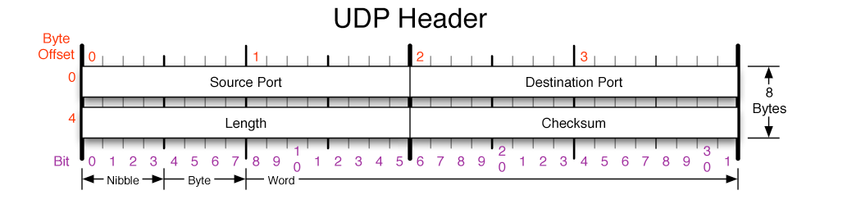
UDP Segment Structure

Slide 62
TCP vs. UDP
TCP
  Connection Oriented – setup required between sending and receiving processes
  Reliable transport – between sending and receiving process
  Flow control – sender won't overwhelm receiver
  Congestion control – throttle sender when network overloaded
  Multiplexing – a client and server can communicate over multiple connections
  does not provide: timing, minimum bandwidth guarantees
UDP
  Unreliable data transfer between sending and receiving process
  Multiplexing
  does not provide: connection setup, reliability, flow control, congestion control, timing, or bandwidth guarantees

Slide 63
Protocols - DNS
Domain Name System
  Maps host names to IP addresses and vice versa
    Forward queries – What is the IP address of paradox.sis.pitt.edu?
    Inverse queries – What is the host name of 136.142.116.28?
DNS stores so-called resource records (RRs)
  Can reveal a lot of information about hosts and addresses

Slide 64
Protocols - DNS
Many protocols employ DNS to translate user supplied names into IP addresses
  HTTP, FTP, SMTP, etc. all use DNS to resolve names
  DNS may add delay to the communications process
  DNS may also be a single point of failure
DNS is an application level protocol, but it is typically not used directly by the user
DNS queries and responses are on port 53 using UDP
  TCP is used for zone transfers

Slide 65
Zone Transfers
Zone
  Name spaces are divided into zones based on separating “periods” in the name
  Example: sis.pitt.edu is a zone
Each zone maintains primary and secondary name servers
  Secondary servers periodically poll primary servers to obtain zone data
  If data has changed, a zone transfer is initiated that downloads the entire database

Slide 66
Protocols - DNS
In addition to address mapping, DNS provides
  Host Aliasing (e.g. paradox.sis.pitt.edu can have two aliases - sis.pitt.edu and www2.sis.pitt.edu)
  Mail Server Aliasing (e.g. x@sis.pitt.edu has to go to mail.sis.pitt.edu)
  Load Distribution (e.g. many sites use replicated web servers each running on a different end-system host)
    DNS responds with the entire set of hosts, but rotates the order periodically

Slide 67
Resource Records
Resource records (RRs) store the hostname to IP address mapping
Each RR has four fields
  [Name, Value, Type, TTL]
  Many different types
  TTL specifies how long the RR is valid

Slide 68
Name Servers
Local Name Servers
  Each ISP has its own name servers - all local machines contact the local name server first
  Local translations are fast, simple and easy to implement
Root Name Servers
  Countable numbers worldwide (13)
  Local servers contact the root server if they cannot resolve a name
Authoritative Name Servers
  Root servers direct local servers to an authoritative name server that has the information related to a host
  Maintain authoritative data for a zone

Slide 69
Protocols - SMTP
De facto standard for email transmission across the Internet
SMTP is a simple, text based protocol
No authentication or security features
  Designed around a time when everyone on the internet trusted one another
Usually located on TCP port 25
Often teams with a “pull” protocol such as POP3 or IMAP to create a working email system

Slide 70
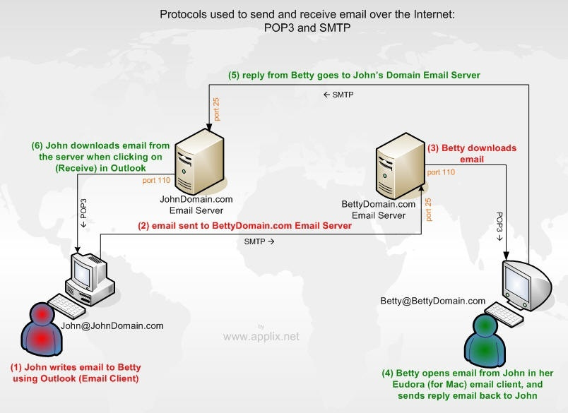
SMTP Operation

Slide 71
Protocols - MIME
Multipurpose Internet Mail Extensions
Extends the format of email to support
  Text in character sets other than US-ASCII
  Non-Text Attachments
  Multi-part message bodies
  Header information on non-ASCII character sets
Also used in other scenarios (i.e., HTTP)
Has been the focus of many security related issues
  In the past – execution of undesirable code, propagation of worms and viruses

Slide 72
Protocols - Telnet
Provides for remote access over network
  Allows a user to logon to a remote server and issue commands as if sitting at a keyboard
Commonly found on TCP port 23
Telnet is a plain-text protocol with no security features
Designed in the “trusted” days of the internet
SSH provides the same functionality with added security benefits

Slide 73
Protocols – SSH
Secure Shell – Usually operates on TCP port 22
Allows for data to be exchanged over a secure channel
  Provides for confidentiality, integrity and authentication through encryption protocols
  Based on the popular OpenSSL encryption suite
SSH is commonly used for remote login and administration (similar to telnet)
Virtually ANY protocol can be tunneled through SSH
  X11, FTP (SFTP), TCP, etc.
  This is both a good and bad thing

Slide 74

FTP: File Transfer Protocol
transfer file to/from remote host
  client/server model
    client: side that initiates transfer (either to/from remote)
    server: remote host
ftp: RFC 959
ftp server: port 21
FTP
user
interface
FTP
client
file transfer
FTP
server
user
at host
remote file
system
local file
system

Slide 75
FTP: separate control, data connections
FTP client contacts FTP server at port 21, using TCP as transport protocol
client authorized over control connection
client browses remote directory by sending commands over control connection.
when server receives file transfer command, server opens 2nd TCP connection (for file) to client
after transferring one file, server closes data connection.
server opens another TCP data connection to transfer another file.
control connection: “out of band”
FTP server maintains “state”: current directory, earlier authentication
TCP control connection
port 21
TCP data connection
port 20
FTP
client
FTP
server

Slide 76
FTP
FTP is still commonly used on the internet today to facilitate easy file transfer.
Uses two channels – Control and Data
FTP can operate in one of two modes
  Active
    FTP client opens a random port > 1023
    Client sends the PORT command to the server, telling it which port to connect on
    Data is transferred on this new “data” channel
  Passive
    FTP server opens a random port
    Sends the PASV command to the FTP client, along with the server IP address and port number to connect to (Server can be different)
    Client connects to specified machine for download.
  Both modes may be difficult to get through a firewall

Slide 77
Protocols – FTP, TFTP, SFTP
FTP is a simple protocol designed to transmit text and binary files
  Usually operates using TCP ports 20 and 21
Plain FTP has been the subject of many security issues
  Like telnet, FTP is a plain text protocol
  FTP is considered insecure and should be avoided if possible
SFTP:
  Secure FTP
    The FTP protocol tunneled over SSH
    Has some problems due to the two channel nature of FTP
  Trivial file transfer protocol
    Has the same functionality as FTP, but differs in implementation
  Both share the same security benefits as SSH
  SFTP should be used in place of FTP whenever possible

Slide 78
Protocols – HTTP and HTTPS
HTTP is the common WWW protocol that allows us to “browse” the internet
  Operates on top of TCP
  Also a plain-text, insecure protocol
  HTTP, like telnet and FTP, has been the subject of many security issues and vulnerabilities
Due to the insecure nature of HTTP, but the necessity of conducting secure business online, HTTPS was conceived
  HTTPS is the HTTP protocol secured using SSL
    Considered generally secure

